Slide 1
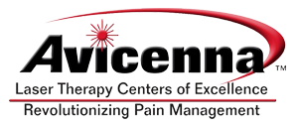
High Power Laser Medicine (HPLM)
Changing the Way
the World Manages Pain

Slide 2
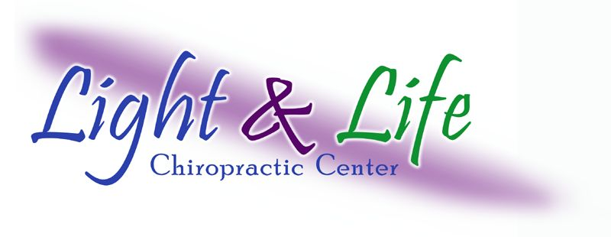
Presented by:
Linda Rich-Consiglio, D.C.
Avicenna Laser Therapy Centers of Excellence

Slide 3
Patient Seminar Format
Please save any questions you have for the question and answer session at the end of our presentation. We look forward to answering your questions.
How many here have ever been treated with a therapeutic laser?
How many here have been treated with our laser?

Slide 4
Who is Avicenna?
Avicenna Laser Technology, Inc. is the parent company of the Avicenna Laser Therapy Center of Excellence in West Palm Beach.
Founded in 2002 by Dr. Bruce Coren and James Ohneck, a biomedical engineer with an expertise in lasers with the intent to develop a therapeutic laser system capable of delivering healing laser energy to depth’s never before achieved in the human body and to offer physician's of all medical disciplines the capability to heal injuries previously refractive to traditional medical care.
In December of 2003 Avicenna was granted a 510-k and became the first “Class IV” or high powered therapeutic laser to be cleared by the FDA .

Slide 5
Who is using Avicenna (HPLM)
There are over 200 Care Providers across the USA
that use Avicenna laser technology
Pain Management Specialists, Orthopedists,
Neurologists, Interventional Pain Management
Doctors, Physical Medicine and Rehab-Physiatrists,
Internal and Family Practice Physicians
Chiropractors and Physical Therapists
Podiatrists, Naturopaths and DOM’s
MLB, NBA, NFL and College Sports Teams
Medical Colleges
The United States Military and VA Hospitals
Veterinarians –Equine and Small Animal

Slide 6
The Avicenna Laser Center of Excellence
The main office and first laser center of excellence in West Palm Beach has been in operation for over 4 years.
The majority of our patients have failed everything that traditional insurance based medicine has to offer.
You don’t have to be a medical failure to come to our clinic.
Our goal is to get patients better as quickly as possible, without the need for drugs, injections, surgery or manual therapy.
At the end of this presentation, Laura will be available to schedule a complimentary consultation with the doctors.

Slide 7
The Avicenna Laser Center of Excellence
Clinic Physicians
Dr. Thomas and Dr. Consiglio have over 40 years of combined clinical experience.
The doctors have had extensive training in laser therapy medicine and have had experience with many different conditions.
The doctors are considered some of the top physicians using this technology in the Hillsborough County area. Now, you as patients have the opportunity to be treated by our physicians.
Now I will turn over the remainder of the lecture to Dr. Thomas who will educate you on our technology and what we do in our clinic to get you better even if you have failed everything traditional medicine has to offer. No case is too challenging!

Slide 8
Current Treatment for Neuropathy
Drug Therapies (Lyrica, Neurontin and Cymbalta ) All with associated side effects
Modalities – Medical Devices such as Anodyne (LED)
Newer Modalities – High Power Laser Therapy (HPLT)

Slide 9
Current Treatment For Other
Neuro-Musculoskeletal Pain
Drug Therapies / Steroidal and Non-Steroidal, Antidepressants, Anticonvulsants
Injections / Typically Steroidal
Physical Medicine - Chiropractic, Massage, Physical Therapy
Surgery
Non-Surgical Spinal Decompression
HPLT – The Only Treatment That Actually Stimulates the Healing of Living Tissue!

Slide 10
LASER
An acronym for:
Light
Amplification by
Stimulated
Emission of
Radiation

Slide 11
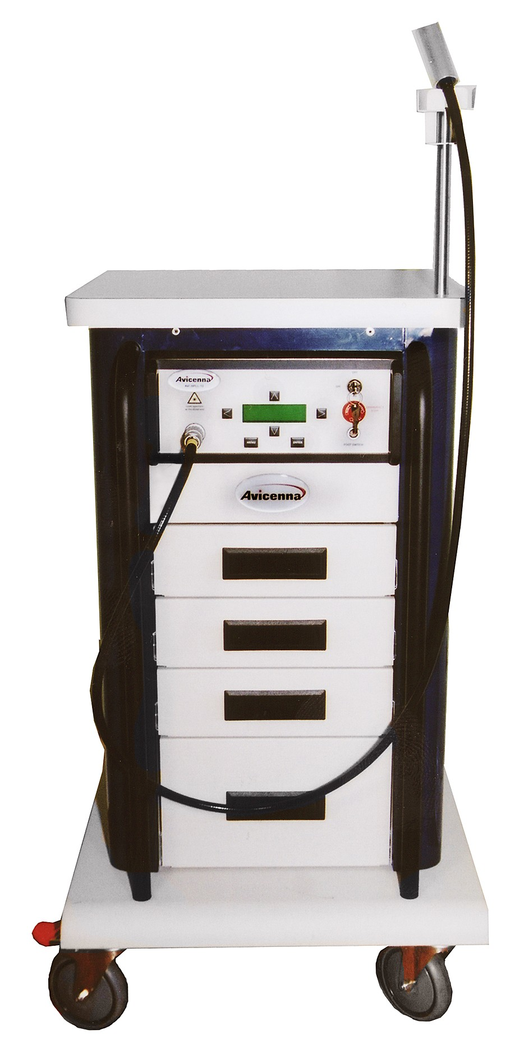
Introducing
the
AVI HPLL-12
The World’s
Most Powerful
Therapeutic Laser

Slide 12
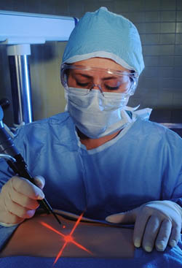
Lasers in Medicine
Surgical Lasers:
are used to cut, coagulate and evaporate tissues. This type of laser replaces the scalpel of the surgeon.
Notes:
Surgical lasers accomplish their objective through excessive heating of tissue are used to cut, coagulate and evaporate tissues. This type of laser replaces the scalpel of the surgeon.
There are several advantages to laser surgery. One of the major benefits is that it is often referred to as "bloodless surgery." Laser procedures usually involve less bleeding than conventional surgery. The heat generated by the laser keeps the surgical site free of germs and reduces the risk of infection. Because a smaller incision is required, laser procedures often take less time (and cost less money) than traditional surgery. Sealing off blood vessels and nerves reduces bleeding, swelling, scarring, pain, and the length of the recovery period.
Of course laser surgery is not without risk. Like traditional surgery, laser surgery can be complicated by:
Hemorrhage
Infection
Perforation of an organ or tissue.
Laser surgery can also involve risks that are not associated with traditional surgical procedures. Being careless or not practicing safe surgical techniques can burn or destroy healthy tissue.
Although many laser surgeries can be performed in a doctor's office rather than in a hospital, the person guiding the laser must be at least as thoroughly trained and highly skilled as someone performing the same procedure in a hospital setting.

Slide 13
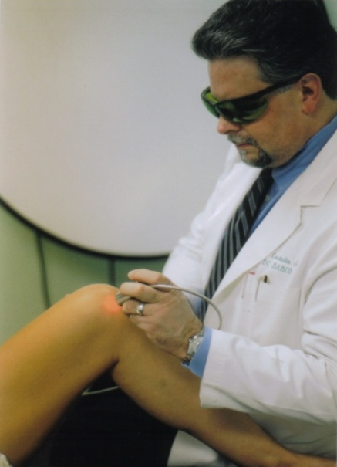
Lasers in Medicine
Therapeutic Lasers: are used for the stimulation of
cell function. The biological effect is photochemical
not thermal (heat), as is the case with surgical
lasers.
Even though the majority of our patients have failed
everything that traditional insurance based medicine
offers, our success rate exceeds 90%.
In 7 years of operation there has never
been a reported side effect.
Notes:
Therapeutic Lasers are used for the stimulation of cell function. The biological effect is photochemical not thermal, as is the case with surgical lasers.

Slide 14
Biological Effects of Therapeutic Lasers
Laser therapy aims to bio-stimulate injured
and dysfunctional tissues. Laser therapy works
at the cellular level to accelerate the bodies
natural ability to heal.
The laser beam will stimulate healing of any
tissue it comes in contact with.
With over 3,000 studies done, the following
are the beneficial effects of light therapy on
tissues and cells.

Slide 15
Summary of LT Biological Effects
Accelerated Tissue Repair and Cell Growth
Faster wound Healing
Reduced Fibrous(Scar) Tissue Formation
Anti-Inflammation
Anti-Pain (Analgesia)
Improved Vascular Activity
Increased Metabolic Activity
Improved Nerve Function
Immunoregulation
Trigger Point Resolution and Acupuncture Pt. Stimulation

Slide 16
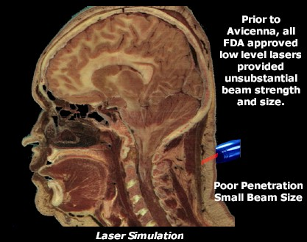
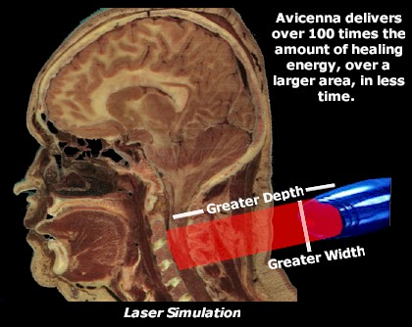
Class III vs. “Class IV” Laser Beams

Slide 17
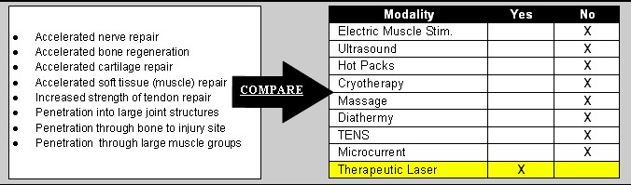
Laser vs. Standard Modalities You May
Have Received Treatment for in the Past
Notes:
The nice thing about laser therapy is… that it is a modality…. that literally “does it all”. It reduces inflammation, reduces pain, accelerates healing, reduces muscle spasms and trigger points, increases circulation and so on…..plus it has been shown to provide one other characteristic that other modalities don’t do…..does you know what that is?
The answer is … Regeneration...it stimulates the proliferation of chondrocytes and osteoblasts. That’s right! Lasers have been shown to reverse inter-articlar loss of cartilage and… accelerate the healing of fractures and bone implants. Additionally, laser has been shown to accelerate the repair of peripheral nerves.

Slide 18
“Effect of HPLM on Neuropathy Pain”
Laser stimulates blood flow and thus brings new and better circulation into the affected tissues.
Laser relieves inflammation around the damaged nerves.
Laser provides an analgesic effect to area.
Laser stimulates repair of damaged nerves as well as new nerve cell growth.
Laser heals open wounds such as diabetic ulcers.

Slide 19
Clinical Translation
“How HPLM Affects Your Pain”
Decreased inflammation of the spine and nerve roots
and all pain receptors.
Increase microcirculation of structures leading to
reduction of swelling around joints and other
structures.
Accelerate healing of bone, cartilage, tendon,
ligaments, muscle and skin.
Decreased formation of scar tissue.
Reduce pain associated with injection therapies.
Decrease or even eliminate need for invasive
procedures.

Slide 20
Why Is HPLM So Effective?
Ability to deliver large amounts of therapeutic laser.
Ability to penetrate deeper than any other modality.
Ability to treat a large surface area. This is very important with neuropathy and back and leg pain as the condition is usually widespread.
The Avicenna laser is the most powerful and advanced therapeutic laser in the world !
It is also the safest !

Slide 21
Goals of
Pain Management Using
High Power Laser Medicine
Relieve Pain and Reduce Inflammation.
Promote Tissue Healing.
Restore Active Range of Patients Motion
and Balance Capabilities.
Do So Without Side Effects.

Slide 22
Some of the Many Applications of High Power Laser Medicine
Back Pain, Spinal Stenosis, Sciatica.
Neuropathy of all causes (Carpal Tunnel Syndrome,
Trigeminal Neuralgia, Tarsal Tunnel Syndrome).
Accelerated Post Surgical Healing (Joint Replacements).
Arthritis (Degenerative Joint Disease of the shoulder,
hip and knees).
Foot and Heel Pain.
Muscle, Ligament and Tendon Injuries.
Ulcerations and Open Wounds.

Slide 23
Creating a Positive Environment for Tissue Healing
In order to get permanent if not long term results for conditions of the back, hip, knee and feet we must address and correct the biomechanical issues or kinetic chain dysfunction of the patient. This will be part of your physical exam.

Slide 24
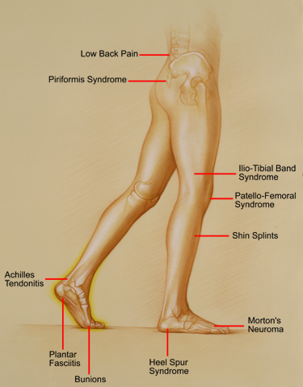
Musculoskeletal Symptomatic Locations & Pathology
With only 17% of the population presenting with normal gait, these conditions are prevalent in the general population.
Copyright Footmaxx™

Slide 25
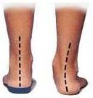
The Effects of a Common Gait Abnormality (Over-Pronation)
Achilles Tendonitis
Plantar Fasciitis
Tarsal Tunnel Syndrome
Bunions, Neuroma
Patella Femoral Syndrome
ITB Syndrome
Low Back Pain and Hip Pain …to name a few.
By fixing this condition as well as other gait issues we can
re-align your joints and spine and create the optimal
environment for the laser to heal your injury and provide
long term if not permanent relief as long as you wear the
Orthotic appliance if needed.

Slide 26
Creating a Positive Environment for Tissue Healing
Once we have identified any gait issues we will recommend the fabrication of a custom Orthotic insert which is designed to put a patient in perfect biomechanical alignment. With this correction, the laser can now heal the inflamed tissue and not only provide the best outcome, it will lesson the number of treatments necessary.
We have helped many patients with chronic back pain who have spent thousands of dollars on (painful injections, dangerous medications, chiropractic and physical therapy) get better just by correcting their gait issues.

Slide 27
Creating a Positive Environment for Tissue Healing
Orthotics are one of the best kept preventative secrets in medicine. If every person had the proper biomechanical alignment, the need for all back pain care and even joint replacements would be cut by more than 50%.
Using an Orthotic to create the perfect biomechanical alignment is similar to aligning a car. Without proper alignment the tires will wear unevenly and pre-maturely. The same will happen to a person’s joints and spine.
Even if you are not experiencing hip, knee or foot pain, and you are interested in preventative medicine, we would be happy to consult with you to see if orthotics may benefit you.

Slide 28
How Can We Help You?
Physical Exam
Biomechanical Gait Analysis
Fabricate Custom Orthotic Inserts to Correct Your Biomechanical Abnormalities to Help Relieve Pressure on the Spine and Joints if Indicated
Begin HPLT
Results are Typically Seen within 3-5 Visits

Slide 29
Question and Answer Session
Please feel free to ask any questions you may have about back pain or any other pain conditions you or your loved ones may be experiencing.

